Slide 1
Looking “Normal” and Seeing “Stars”: Table Designs Working Together
Deborah Melkin
July 15, 2020

Slide 2



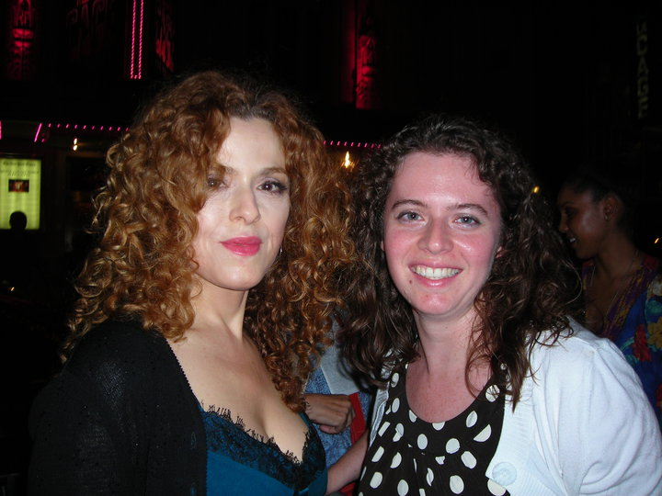
WHO AM I?
20 years as a DBA
Mainly work with SQL Server
Mainly work with OLTP but have worked with some data marts.
NESQL Board Member
SQL Saturday\User Group Speaker
IDERA ACE Class of 2020
Speaker Idol Winner 2019
Pronouns: she\her
Random facts:
I’m the alto section leader in my choir
I go to bluegrass jams regularly
I’ve been learning guitar and now mandolin
I am a bit of a musical theater geek
I became a Red Sox fan after 2003 ALCS, Game 7

Slide 3
Agenda
Normal Forms
Star Schemas
Normal Forms and Star Schemas Working Together

Slide 4
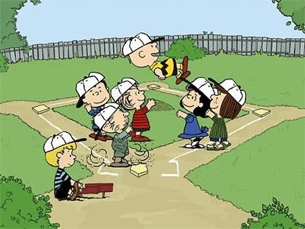


Requirements
Every game has a home team and an away team.
There are two different leagues:
American League (AL) & National League (NL)
The biggest difference is that pitchers don’t bat in the AL.
Games are broken down into innings.
An Inning is 3 outs per team.
There are 9 innings in a game.
Extra innings are played a tie at the end of 9 innings until the tie is broken.
A player on a team can play one or more positions.
For batters, we want to keep track of:
Hits – number of time they hit the ball and made it safely to a base
RBI (Runs Batted In) – credits the batter for making a play that allows runs to be scored
For pitchers, we want to keep track of:
Number of pitches during the inning
Number of pitches that were strikes
American League:
National League:
https://www.baseball-reference.com/
Red Sox Logo: This Photo by Unknown Author is licensed under CC BY-SA
Washington Nationals Logo: This Photo by Unknown Author is licensed under CC BY-SA
Peanuts Pic: This Photo by Unknown Author is licensed under CC BY-NC-ND

Slide 5
Normal Forms
The Key,
The Whole Key,
Nothing But the Key,
So help me, Codd!

Slide 6
Why Use Normal Forms
Eliminate data redundancies and incompleteness
Data manipulation
Clean database structures
Extensible schema
If you don’t know what type of database you are working with, it is likely Normal Form.
Notes:
List borrowed from https://database.guide/what-is-normalization/

Slide 7
What is Normalization?
“Tables are normalized when they represent propositions about entities of one type.”
Notes:
Inside Microsoft SQL Server 2008: T-SQL Querying, Itzik Ben-Gan

Slide 8
Normal Forms
1st
2nd
Boyce-Codd
3rd
4th
5th
Domain Key
6th
Essential Tuple
Elementary Key

Slide 9
What Level of Normal Do We Want?
FIRST NORMAL FORM
SECOND NORMAL FORM
THIRD NORMAL FORM
BOYCE-CODD NORMAL FORM
(optional)
The Key,
The Whole Key,
Nothing But the Key,
So Help Me, Codd!

Slide 10
Tables Through The Normal Forms
First Normal Form: All columns are atomic.

Slide 11
Tables Through The Normal Forms
SECOND NORMAL FORM: And every nonkey column must be functionally dependent on the entire key.

Slide 12
Tables Through The Normal Forms
THIRD NORMAL FORM: And every nonkey column must be nontransitively dependent on every key.

Slide 13
Tables Through The Normal Forms
BOYCE-CODD NORMAL FORM: And every determinant must be a key.
Notes:
Determinant: the independent part of a functional dependency

Slide 14
Tables Through The Normal Forms
FOURTH NORMAL FORM: And there must be no nontrivial multivalued dependencies that are not functional dependencies.

Slide 15
Tables Through The Normal Forms
FIFTH NORMAL FORM: And every nontrivial join dependency in the table is implied by the keys of the table.

Slide 16

Why Denormal?
Performance
History

Slide 17
Star Schema
To quote Joe Friday,
“All we want are the facts!”
Notes:
Definitions came from The Data Warehouse Lifecycle Toolkit, Kimball et al
Joe Friday is the main character from the show (later turned into a movie), Dragnet. https://en.wikipedia.org/wiki/Joe_Friday

Slide 18
Why Use Star Schema
Structures the data so it’s intuitive to business users
Fast query performance
Preferred for data warehouse/business intelligence presentations
Simplicity and “Understandability”

Slide 19
What is a Star Schema?
“The generic representation of a dimensional model … in which a fact table with a composite key is joined to a number of single level dimension tables, each with a single primary key.”
Notes:
The Data Warehouse Lifecycle Toolkit

Slide 20
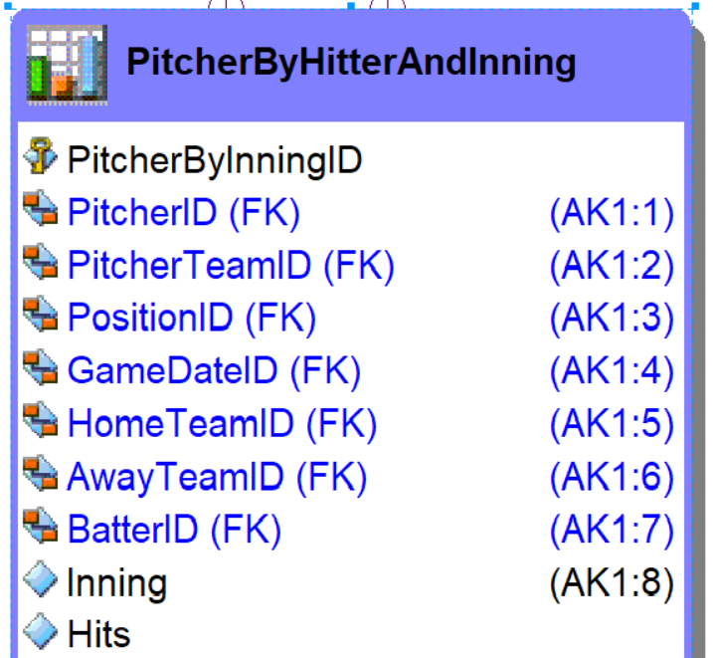
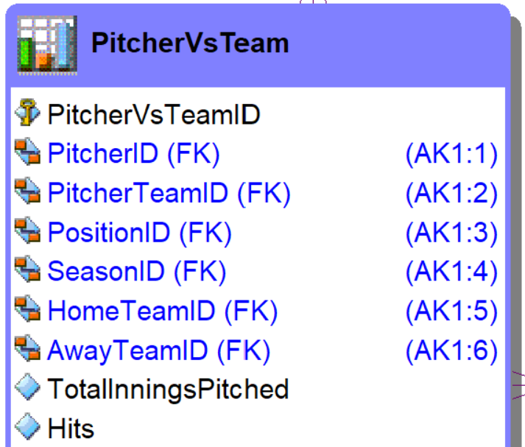
Fact
“In a dimensional model, the central table with numeric performance measurements characterized by a composite key, each of whose elements is a foreign key drawn from a dimension table.”
Keyword:
Granularity

Slide 21
Dimension
“A table in a dimensional model with a single part primary key and descriptive attribute columns.”
Multiple types of dimension tables:
Conformed
Junk
Degenerated
Role playing
Slowly Changing Dimensions
Types 0 - 7

Slide 22
Snowflake
“A normalized dimension where a flat, single table dimension is decomposed into a tree structure with potentially many nesting levels. In dimensional modeling, the fact tables in both a snowflake and star schema would be identical, but the dimensions in a snowflake are presented in third normal form.”

Slide 23
Bridge
“A table with a multipart key capturing a many-to-many relationship that can’t be accommodated by the natural granularity of a single fact or dimension table. Serves to bridge between the fact and dimension tables to support many-valued dimension attributes or ragged hierarchies.”

Slide 24
Factless Fact
“A fact table that has no facts but captures the many-to-many relationships between the dimension keys. Most often used to represent events or coverage information that does not appear in other fact tables.

Slide 25
Normal and Stars Working Together

Slide 26
Reviewing the Differences
Normal Form
Star Schema
All about the KEY
How the data is related
Relationship Types have names
Optimizes Writes over Reads
The first four normal forms emphasize the ease of updates
Too many indexes on a table affect write performance
All about the FACT
How the data functions
Table Types have names
Optimizes Reads over Writes
Fact tables store aggregates and measures
Index based on data usage

Slide 27
Finding similarities in the differences
Normal Form
Star Schema
Lookup Tables
Mapping Tables
Super\Subtype Tables
SQL Server Database Engine
Dimensions
Bridges
Snowflakes
SQL Server Database Engine

Slide 28
Operational Data Store
Normal Form
OLTP 1
OLTP 2
OLTP 3
A relational database used to combine data from different sources before ETL\ELT process to move data into the data warehouse or mart.
Some data warehousing methodologies say that you must have an ODS as part of the ETL process.
Operational Data Store
Star Schema
Data Warehouse

Slide 29
In Conclusion

Slide 30
Why is this important?
It’s all about the data
Knowing how the data used dictates …
The type of model you use
The type of tables you create
The level of normalization
The facts and dimensions to create
How to move the data between the systems

Slide 31
Additional Resources – Normal Forms
Inside Microsoft SQL Server 2008: T-SQL Querying. Itzik Ben-Gan, Lubor Kollar, Dejan Sarka, Steve Kass.
https://www.bkent.net/Doc/simple5.htm William Kent, "A Simple Guide to Five Normal Forms in Relational Database Theory", Communications of the ACM 26(2), Feb. 1983, 120-125)
Additional Normal Forms:
Elementary Key Normal Form: http://what-when-how.com/Tutorial/topic-1114galv/Database-Design-and-Relational-Theory-167.html
Essential Tuple Normal Form: https://researcher.watson.ibm.com/researcher/files/us-fagin/icdt12.pdf
Notes:
https://www.amazon.com/Data-Warehouse-Toolkit-Definitive-Dimensional-ebook/dp/B00DRZX6XS/ref=sr_1_1?keywords=The+Data+Warehouse+Lifecycle+Toolkit&qid=1550957898&s=gateway&sr=8-1
https://www.amazon.com/Inside-Microsoft%C2%AE-SQL-Server%C2%AE-2008/dp/0735626022/ref=sr_1_fkmrnull_1?keywords=inside+microsoft+sql+server+2008&qid=1552266198&s=gateway&sr=8-1-fkmrnull

Slide 32
Additional Resources – Star Schemas
The Data Warehouse Lifecycle Toolkit. Ralph Kimball, Margy Ross, Warren Thornthwaite, Joy Mundy, Bob Becker.
https://www.kimballgroup.com/data-warehouse-business-intelligence-resources/kimball-techniques/dimensional-modeling-techniques/
Building the Data Warehouse. William H. Inmon.
Notes:
https://www.amazon.com/Data-Warehouse-Toolkit-Definitive-Dimensional-ebook/dp/B00DRZX6XS/ref=sr_1_1?keywords=The+Data+Warehouse+Lifecycle+Toolkit&qid=1550957898&s=gateway&sr=8-1
https://www.amazon.com/Inside-Microsoft%C2%AE-SQL-Server%C2%AE-2008/dp/0735626022/ref=sr_1_fkmrnull_1?keywords=inside+microsoft+sql+server+2008&qid=1552266198&s=gateway&sr=8-1-fkmrnull

Slide 33


Any Questions, Comments?
Email: dgmelkin@gmail.com
Twitter: @dgmelkin
Blog: debthedba.wordpress.com

Slide 34
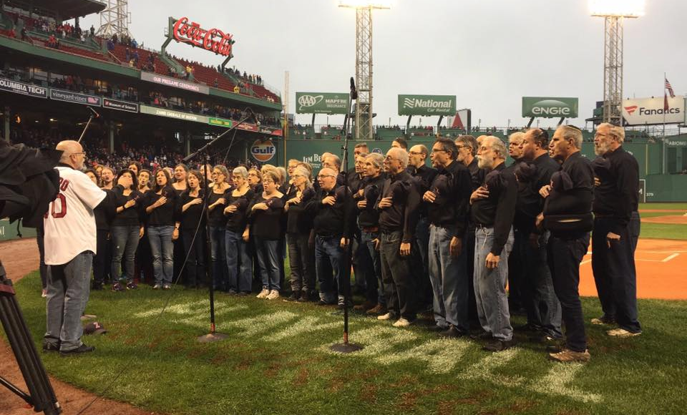
Thanks For Coming!
Notes:
Picture courtesy of Josh Jacobson and the Zamir Chorale of Boston

